Slide 1
Motion Sickness Reduction for 6-DoF-Navigation in a Virtual Solar System

Slide 2
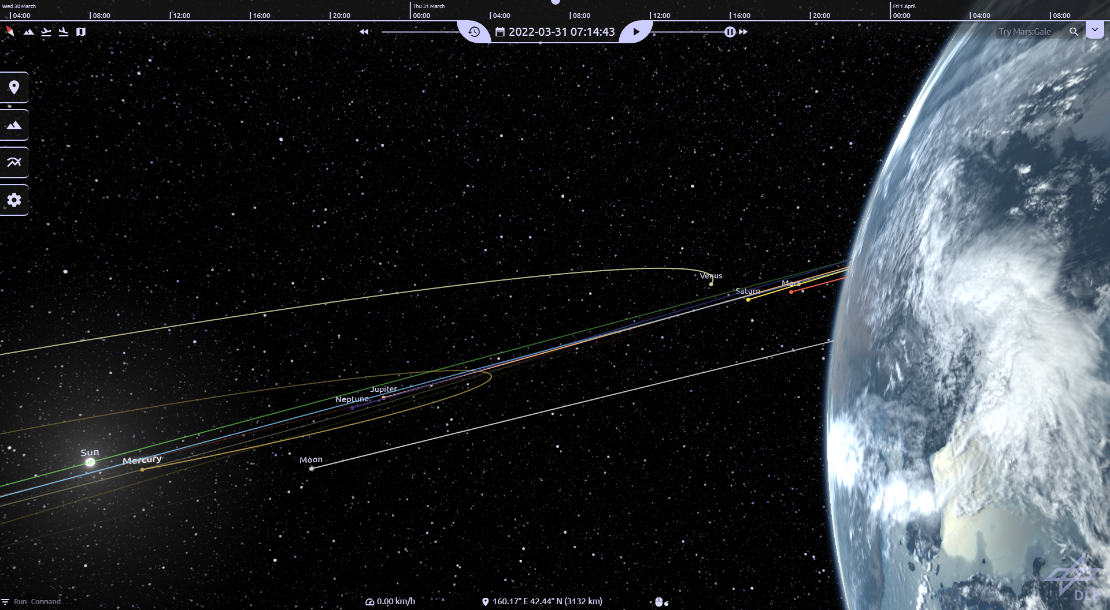
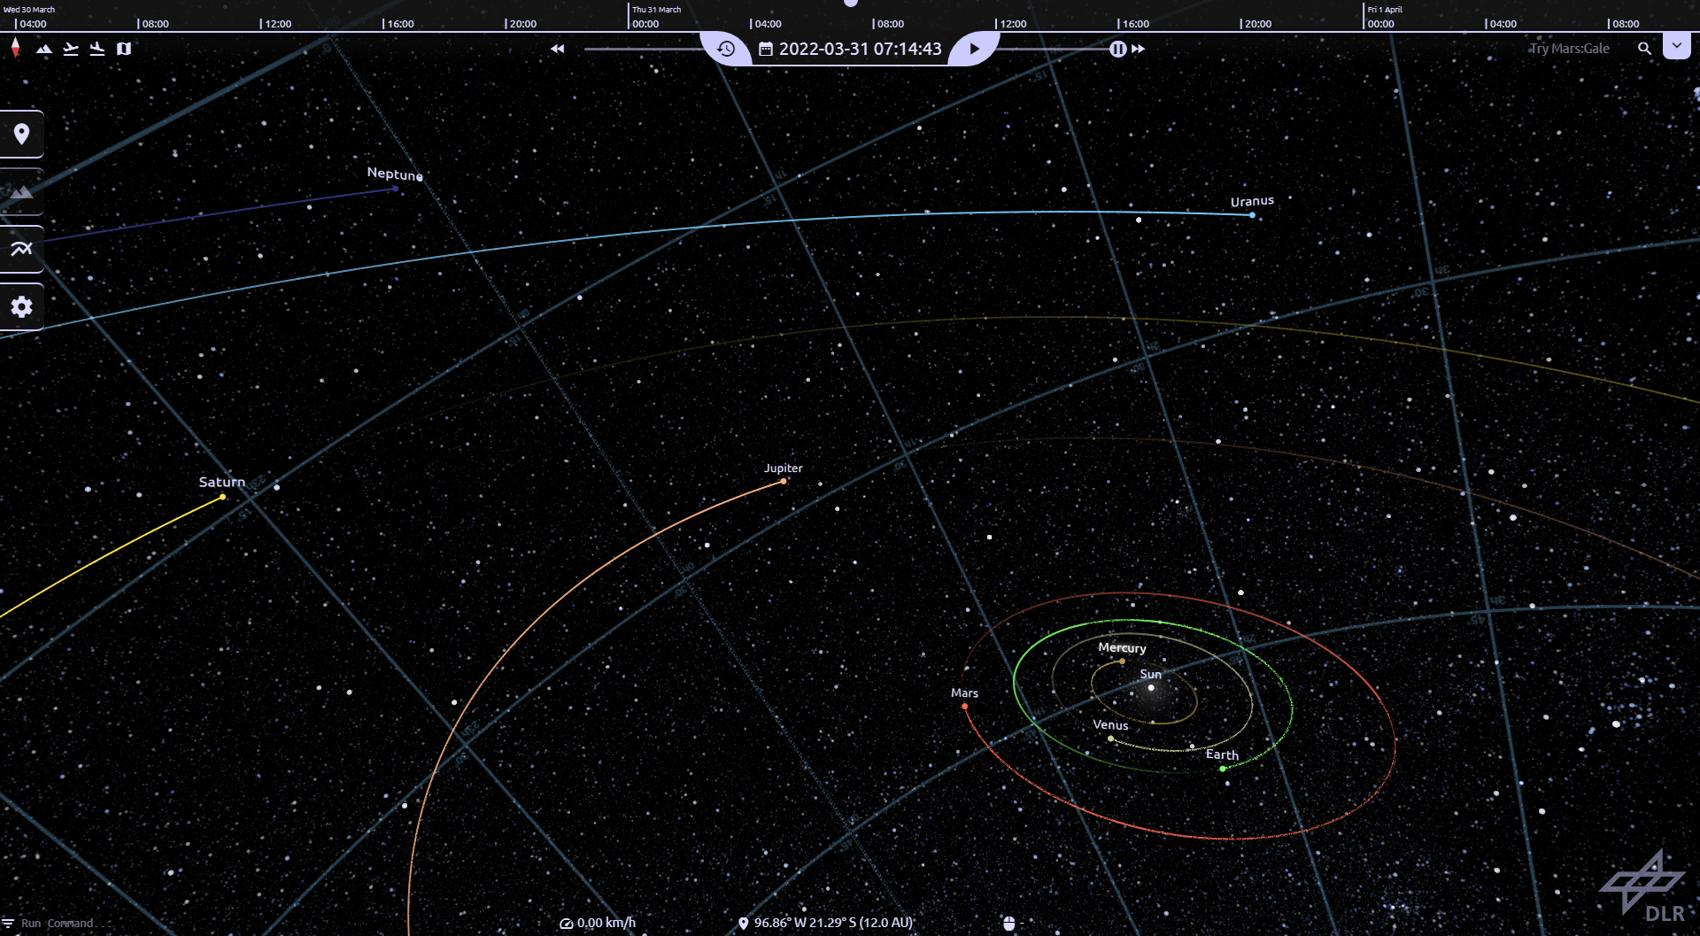
What is CosmoScout VR?
Virtual Reality Simulation of our solar system
High resolution elevation models and satellite imagery
Real-time exploration of entire planets and space missions
Scientific Visualisation of Data in VR
Notes:
- Simulation of space *and* time

Slide 3
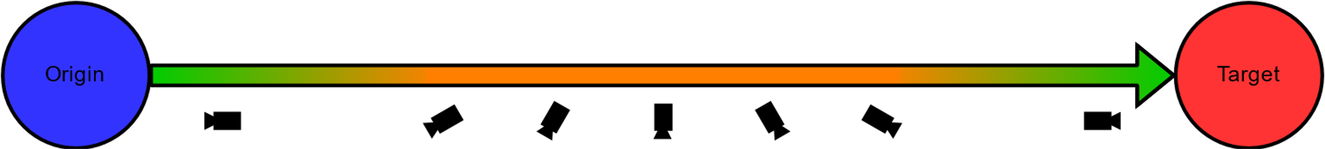
What Problems Do I Want To Fix?
6 DoF Navigation Controls with remote lead to complex rotations in free movement
Disorientation increases likelihood of motion sickness
Automatic Navigation uses simultaneous translation and rotation during travel path
Quick rotation at peak speed may induce sickness symptoms
Occurs during bookmark navigation and landing/ascending animation
Notes:
- Romote Controler does not allow strict separation between movements/rotations around DoF
- complex rotation can disorient the user and increase likelihood of motion sickness symptoms

Slide 4
What Causes Motion Sickness?
Sensory Conflict Theory
Information from user's senses conflict with each other or with the expectation in given context
Sensory conflict due to vection though as one of the prime causes of cybersickness
Postural Instability Theory
State in which uncontrolled movements of the perception and action system happen
Postural instability i.e., lateral-medial body sway often precedes experiences of motion sickness
People who are naturally unstable seem to be more likely to become motion sick during VR
Saredakis D., Szpak A., Birckhead B., Keage H. A. D., Rizzo A., Loetscher T.:
Factors Associated With Virtual Reality Sickness in Head-Mounted Displays: A Systematic review and Meta-Analysis.
March 2020. https://doi.org/10.3389/fnhum.2020.00096
Notes:
Sensory Conflict Theory
- Information from senses does not match each other or expectation
- illusion of self movement argued to be main cause (visual information does not match somatosensory = haptic perception, spacial position and movement relative to support surface and each other)
Postural Instability Theory
- uncontrolled small movements like natural body sway
- usually happens before motion sickness
- naturally unstable ppl may be at a higher risk to show symptoms
Vergence-Accomodation Conflict
- Vergence = lateral eye movement when focusing on object that move toward or away from the user
- Accomodation = act of focusing on that object -> occurs at fixed screen depth in HMD VR
- highly active scenes may provoke this due to more changes in stimulus distance
- unable to fix this with current technology (Vignette partial fix)

Slide 5
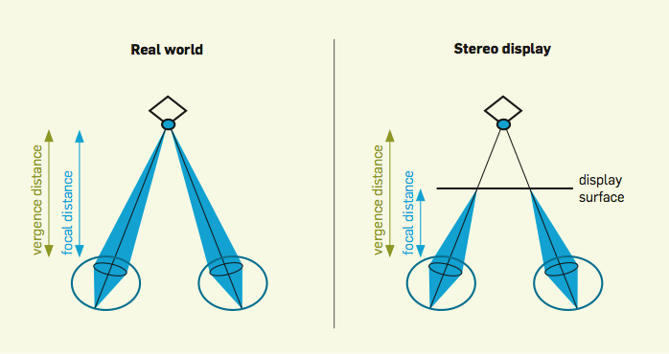
What Causes Motion Sickness?
Vergence-Accomodation Conflict Theory
Vergence refers to lateral eye movement to adjust to objects moving towards or away from the user together with the proces of focusing on the object (Accomodation)
Process does not occur in stereoscopic displays, where accomodation occurs at fixed sceen depth
Kroeker K. L.: Looking beyond stereoscopic 3D's revival. August 2010. https://doi.org/10.1145/1787234.1787241
Saredakis D., Szpak A., Birckhead B., Keage H. A. D., Rizzo A., Loetscher T.:
Factors Associated With Virtual Reality Sickness in Head-Mounted Displays: A Systematic review and Meta-Analysis.
March 2020. https://doi.org/10.3389/fnhum.2020.00096
Notes:
Vergence-Accomodation Conflict
- Vergence = lateral eye movement when focusing on object that move toward or away from the user
- Accomodation = act of focusing on that object -> occurs at fixed screen depth in HMD VR
- highly active scenes may provoke this due to more changes in stimulus distance
- unable to fix this with current technology (Vignette partial fix)

Slide 6
How To Mitigate The Problems? - Automatic Navigation Overhaul
Orbit-to-Orbit Navigation
Travel between objects in interplanetary space
Travel in the orbit of an object
Orbit-to-Surface Navigation
Travel to and from the surface to the standard orbit distance
Surface-to-Surface Navigation
Travel between different location on the same body
Notes:
Sensory Conflict Theory
- Information from senses does not match each other or expectation
- illusion of self movement argued to be main cause (visual information does not match somatosensory = haptic perception, spacial position and movement relative to support surface and each other)
Postural Instability Theory
- uncontrolled small movements like natural body sway
- usually happens before motion sickness
- naturally unstable ppl may be at a higher risk to show symptoms
Vergence-Accomodation Conflict
- Vergence = lateral eye movement when focusing on object that move toward or away from the user
- Accomodation = act of focusing on that object -> occurs at fixed screen depth in HMD VR
- highly active scenes may provoke this due to more changes in stimulus distance
- unable to fix this with current technology (Vignette partial fix)

Slide 7
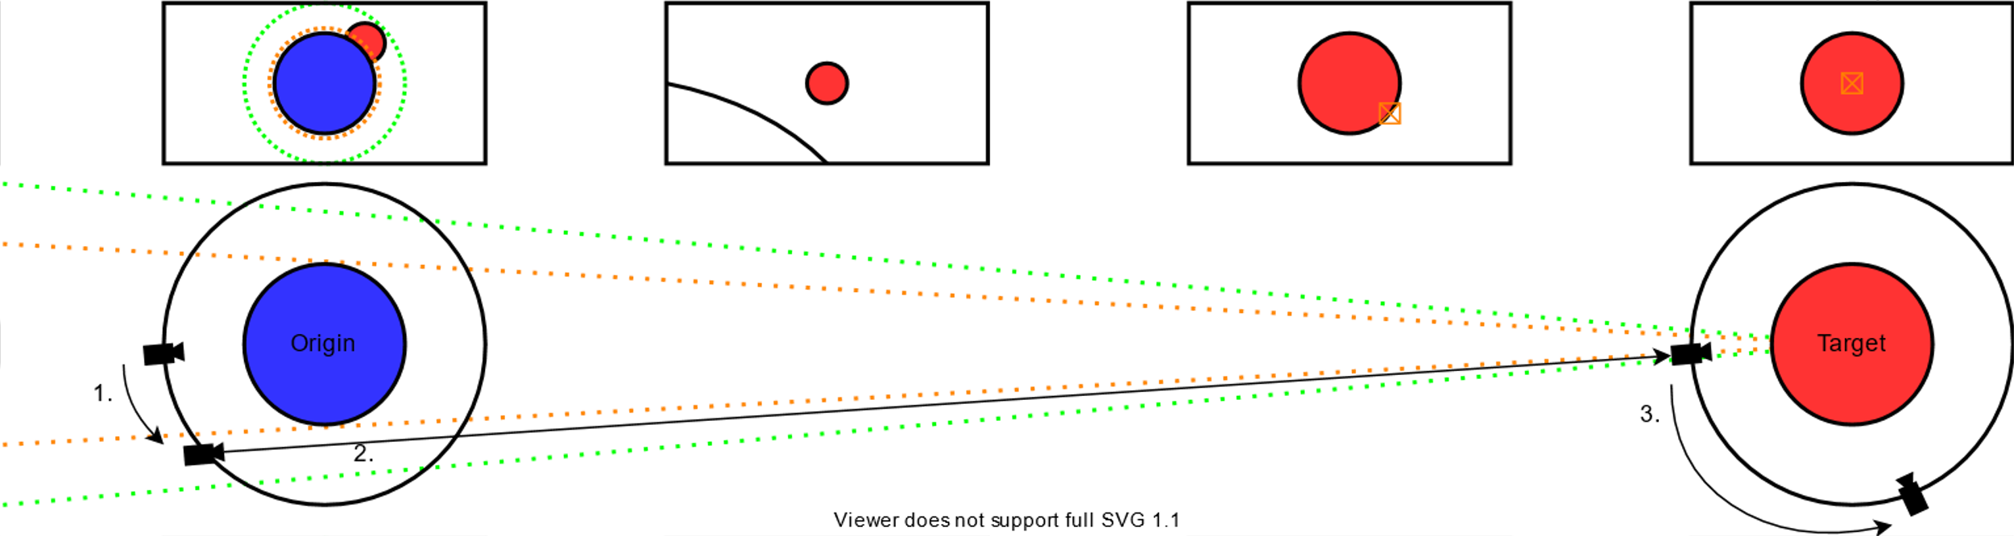
How To Mitigate The Problems? - Automatic Navigation Overhaul
Notes:
Overhaul Automatic Navigation
- Interplanetary (movement between objects & orbiting around object)
- decouple rotation from translation (rotate first, then move)
- change orbit by "turning" planet (move along arc)
- predictable -> easier to mitigate sickness

Slide 8
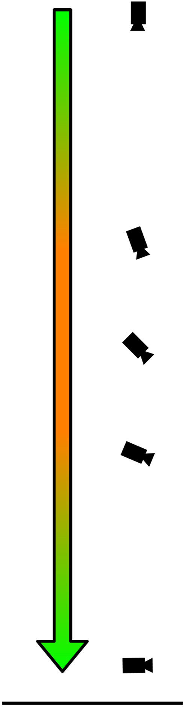
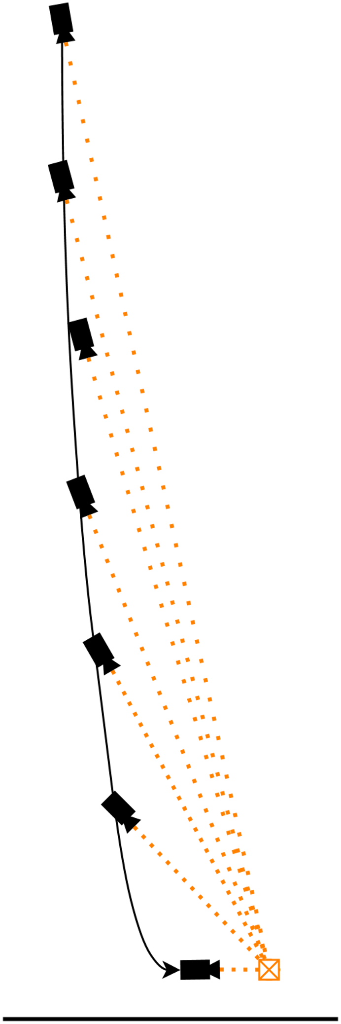
How To Mitigate The Problems? - Automatic Navigation Overhaul
Travel paths moving the user forwards
Move in orbit over and rotate towards target
Lock view direction onto traget's orientation and move along parabola curve down to target
Simple, predictable movements to mitigate sensory conflicts
Parabola movement instead of linear to "move into" target orientation
Notes:
Overhaul Automatic Navigation
- more natural "gliding" curve down to fit into target orientation
- rotate in orbit so target orientation is pointing "up", then glide down
- view either fixed on point along targets orientation vector, or "ahead" on the parabola path
- travel along surface similar to low orbit travel, lifting up towards target, on short distances where user is not lifted into orbit, user may need to be rotated at the end of travel to match final orientation

Slide 9
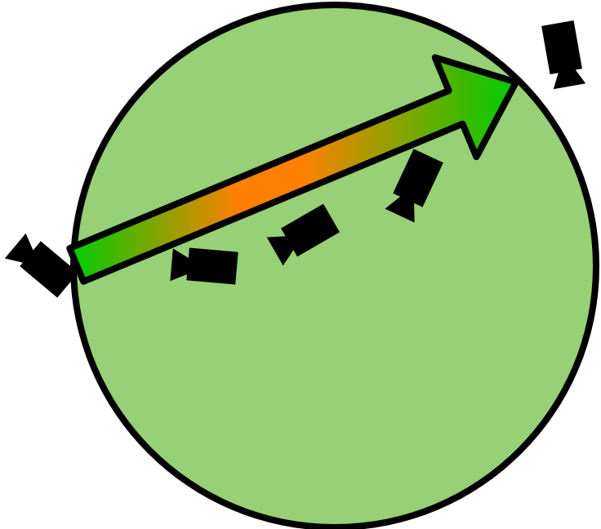
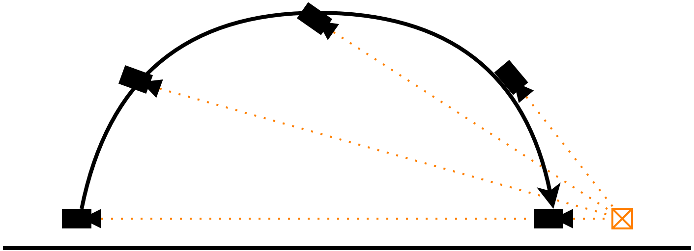
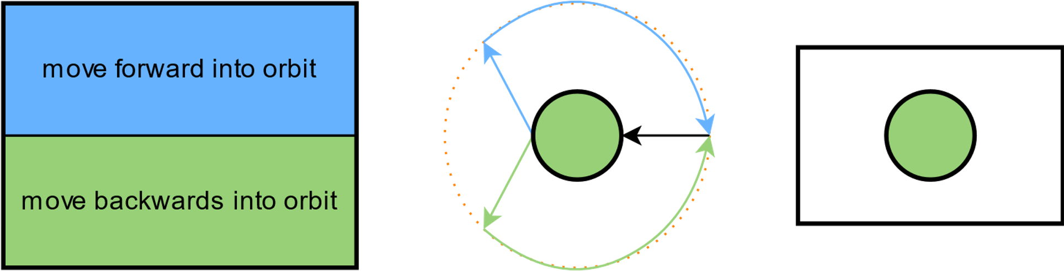
How To Mitigate The Problems? - Automatic Navigation Overhaul
Old method ignores collisions or target location
Surface travel also via curves, lifting user to new location (short distances)
Long distance travel via orbit
Notes:
Overhaul Automatic Navigation
- old travel directly & ignores collision or location of target location
- travel along surface similar to low orbit travel, lifting up towards target, on short distances where user is not lifted into orbit, user may need to be rotated at the end of travel to match final orientation

Slide 10
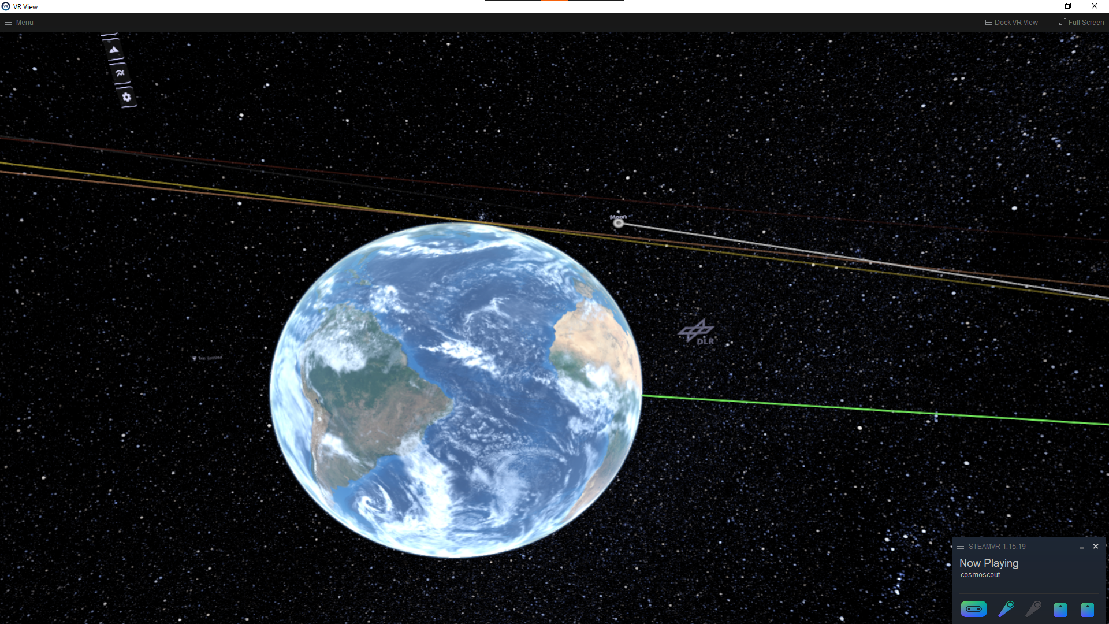
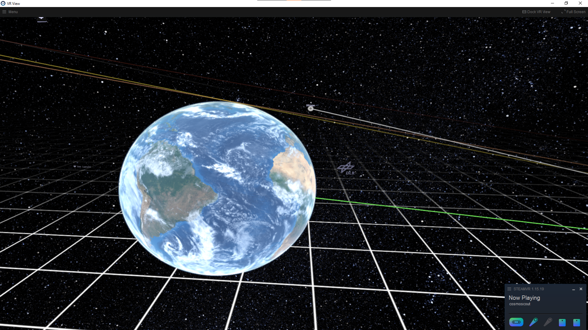
How To Mitigate The Problems? - Floor Grid
Provides a stable simulated frame of reference during interplanetary free and automatic navigation
Assist with postural stability and sensory conflicts
Change interaction context from Observer moving through the simulation to solar system being simulated and manipulated around the fixed user
Mitigates sensory conflict problems as the user is not moving, and VR orientation mirrors real-world situation
Notes:
Floor Grid
- stable simulated frame of reference to assist postural stability and sensory conflicts
- change interaction context to fixed user w/ simulation moving around them
- may require additional changes to control scheme (not part of the project)

Slide 11
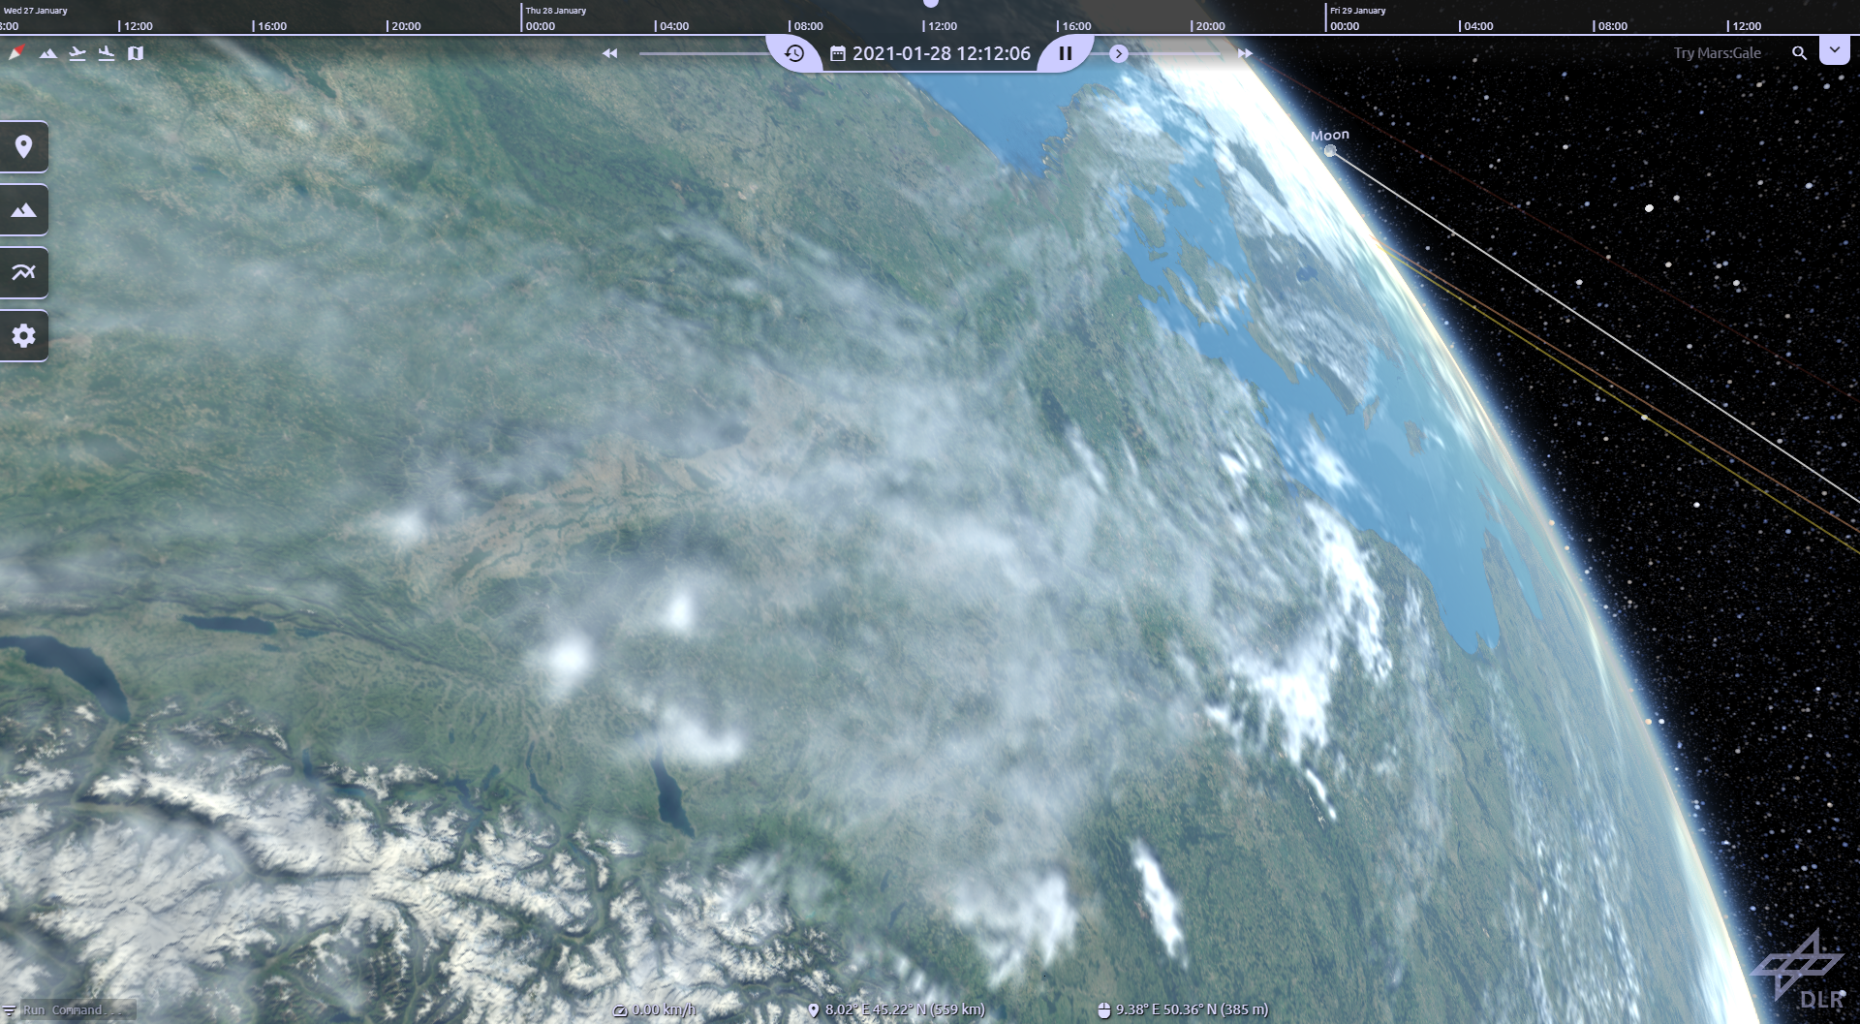
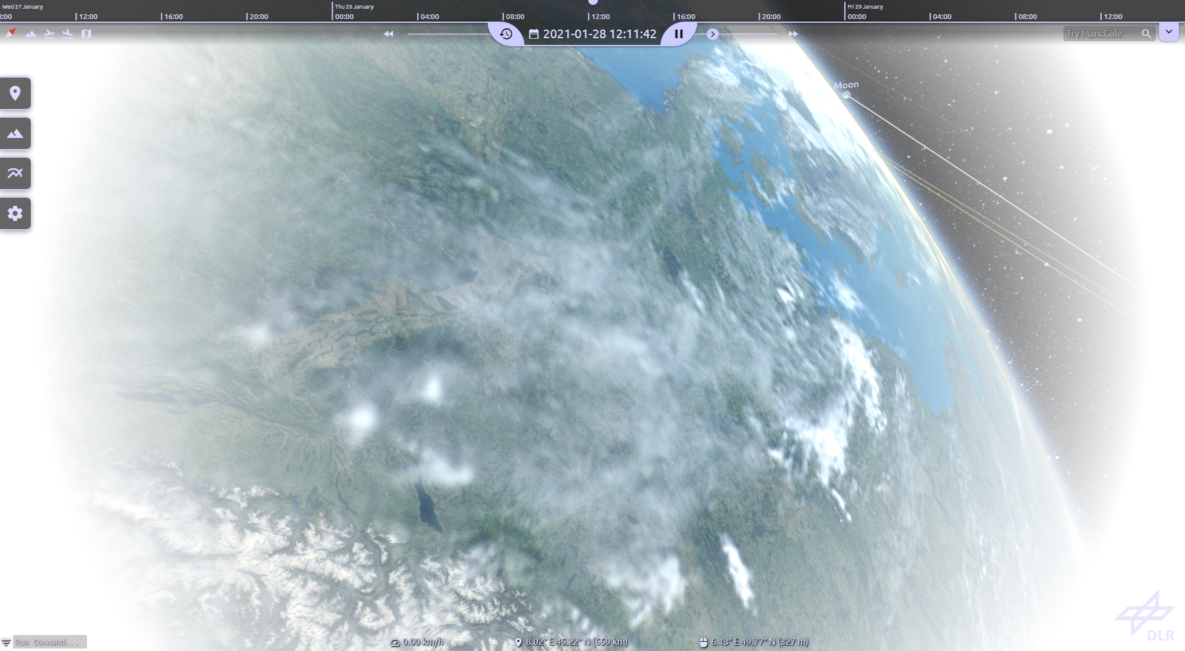
How To Mitigate The Problems? - FoV Vignette
Popular method of cybersickness reduction
Applications with high detail and/or movement in peripheral areas of vision
User tends to react to High peripheral detail / movement by moving their eyes instead of their head
Employ vignette to limit users FoV, focusing on the center of HMD lenses
Post-Processing shader draws vignette radius according to movement speed
Notes:
FoV Vignette
- popular & proven method of sickness mitigation, especially for application with high detail/movement (in peripheral vision)
- vergence & accomodation
- focus user on center of HMD lenses (sharper image) as moving eyes instead of head leads to unfocused images straining the eyes and increasing risk of sickness
- vignette drawn as post-processing shader w/ radius tighter the faster the user is moving

Slide 12
Next Steps: How To Measure the Effectiveness?
Within subjects user study to measure effectiveness of cybersickness mitigations
Measure general severity of cybersickness while using CosmoScout VR
Navigation tasks with and without developed mitigation methods
Interplanetary 6-DoF-Navigation with and without grid
Automatic navigation using old and new movement, potentally also testing teleportation
Measuring cybersickness severity and feedback to the navigation methods
Continuous evaluation of cybersickness over time inside simulation
Feedback and evaluation of features during and after navigation tasks
Feedback and SSQ after session
Notes:
User Study
- within subjects study (all subjects test all variants) because of small subject group, counterbalanced if possible (to avoid order of tasks as a disruptive factor)
- test developed improvements in different navigation tasks and compare to previous situation
- grid/no grid, vignette/no vignette, old navigation/new navigation/teleportation(?)
- continuous feedback of cybersickness score every few minutes inside simulation (sickness/time) to correlate to tasks/features and their feedback
- feedback/evaluation of each feature after/during navigation task to measure reception/effectiveness of features
- feedback and SSQ after session to measure overall sickness score for CosmoScout

